Slide 1
BVI- San Antonio TX 6/15/18
Oregon Commission for the Blind
Collaborative Business Services:
Co-location with WSOs; collaboration with WA & OR General Agencies

Slide 2
Topics for today’s presentation
How Oregon Commission for the Blind (OCB) is approaching and striving to meet the requirements of WIOA
How collaboration has helped Oregon Commission for the Blind leverage resources as a smaller agency
Additional plans and projects that will continue to increase collaboration and maximize resources

Slide 3
America’s Job Centers in Oregon
WorkSource Oregon (WSO) is the name Oregon has used to brand our America’s Job Centers. WSO is a network of public and private partners who work together to effectively respond to workforce challenges through high-quality services to individuals and businesses, resulting in job attainment, retention and advancement.
Oregon WorkForce Investment Boards (OWIBs) are funded by WIOA business led boards which oversee state workforce development services. Workforce development boards (WDBs) serve all fifty states.
Local Leadership Team (LLT) meetings are organized and facilitated by the OWIBs across the state of Oregon. The teams are comprised of America’s Job Center Managers, leaders from Oregon Commission for the Blind (OCB),Oregon Vocational Rehabilitation and WorkSource partners and other Educational & DHS partners.
Coordinated Business Services Teams are forming throughout Oregon and OCB has taken an active role in the roll out of these teams. It is a coordinated approach utilizing a Business Services Representative from WorkSource as the main point of contact who then funnels employer requests to partner agencies to help meet employer needs.
Memorandums Of Understanding (MOUs) set up between OCB and OWIBs throughout Oregon to establish partnerships, cost sharing agreements and co-location parameters.

Slide 4
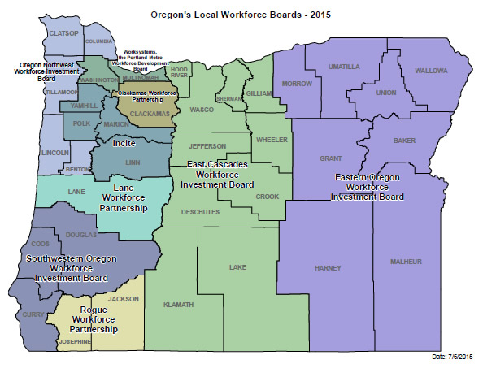
Workforce Investment Boards

Slide 5
Interstate Disability Employment Alliance
Met NET PoC-Business Relations Coordinator from WA, Karen Miceli through working together with the JDVRTAC
Monthly Regional NET calls with OR, WA, ID, AK
Respond to employers & SHRM activities that cross boarder lines
Developing a presentation for future SHRM event
IDEA- Reverse Job Fair 6/8/18
OR VR & OCB
WA DVR
VA
Tribal
WorkSource OR & WA

Slide 6
OCB & OVR Collaborative Business Coordination
Meet with OVR BRC weekly- updates, planning & coordination
Attend SHRM events together, respond to employer contacts jointly
Host VR & OCB resource booths at job fairs
SRC Business Committee
Developing USBLN / Business Roundtable
OCB “Jobsville”

Slide 7
Goals
Collaborated WIOA teams statewide to help our agency keep our finger on the pulse of what is happening regionally in teams
Virtual trainings for CRPs to build business engagement capacity
Develop a Business Roundtable/ USBLN chapter in Oregon

Slide 8
Thank you!
Morgan Rincon- Oliveira M.S., CRC
&
Molly James M.S., CRC
Business Relations Coordinators
Oregon Commission for the Blind

